Slide 1
DMBI 2018 Data Hackathon Embedding with TensorFlow Tutorial
Efrat Solodnik & Zohar Komarovsky, Taboola Algo Team
May 2018

Slide 2
Outline
Who are we?
Basic ML - linear model
How to handle categorical features – Embedding, OOV, TensorBoard
Intro to TensorFlow
Workshop

Slide 3

You’ve Seen Us Before
Enabling people to discover information at that moment when they’re likely to engage

Slide 4







Exclusive Partnerships With Thousands of Top Sites
WORKING WITH TABOOLA
News | Business | Finance
Entertainment | Lifestyle
Tech
Apps | Games

Slide 5
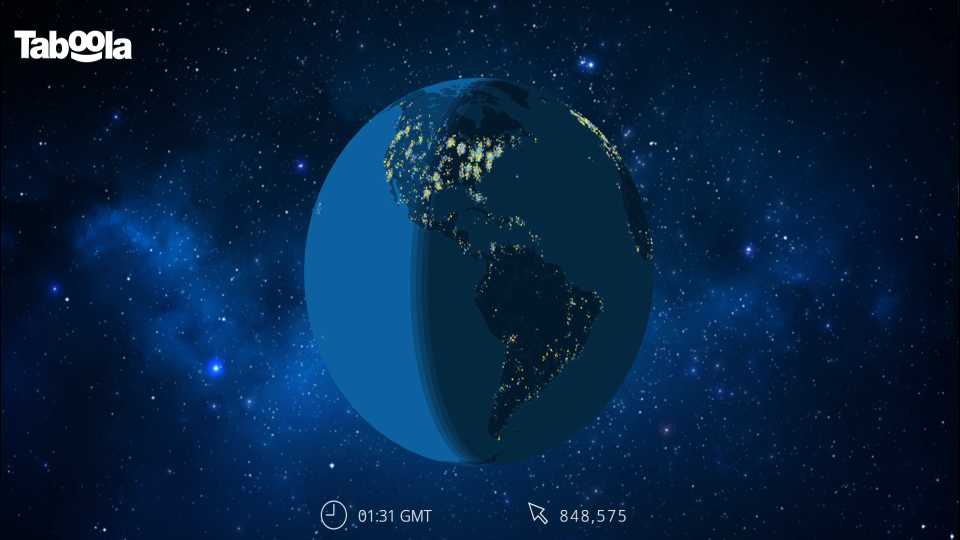
Powering Over 1.3B Moments of Discovery Every Month
HUGE REACH
88%
US Mobile Internet Users Reached
1.3B
Moments of Discovery
1B
Monthly Unique Users Globally
Notes:
Taboola reaches users all over the world. We are exclusively partnered with the largest and most premium sites in the world. We work with about 5,000 premium sites, and reach over 1 billion users Globally.

Slide 6






Strong Financials and Rapid Growth $157M Funding, $100M in the Bank
2017
2016
Acquired Commerce Sciences for personalization tech
$550M
Acquired ConvertMedia to double down on video
2015
$300M
Became the largest global discovery platform
2012
$1M+
Launched “Sponsored Content” and moved into articles, galleries
2007
Founded Taboola to recommend videos
Notes:
The technology we developed and the strong relationships we’ve built with key publishers and brands helped to accelerate our growth.
It also attracted investment from large financial institutions like Fidelity and strategic investments from Comcast, Yahoo Japan and Baidu. With Aol being our most recent investor.
We are financially strong, raising $157m to date with the majority of that still being cash in the bank. In a dynamic market, we are well positioned to continue leading the way.

Slide 7

The Largest Content Recommendation Platform in the World
Taboola: Company Overview
1.3B
Monthly Unique Users Globally
Worldwide Desktop
Google Sites 63.2%
Taboola 43.6%
Facebook 39.2%
Outbrain 26.1%
Canada
UK
12B
26B
Germany
China
15B
1B
87%
US Mobile Internet Users Reached
USA
France
135B
23B
Japan
Mexico
India
Korea
94B
9B
24B
7B
Brazil
US Smartphone
Google Sites 95.9%
Facebook 94.9%
Taboola 87.3%
Twitter 67.4%
19B
1.5B
Australia
5B
Monthly Clicks
Taboola Monthly Recommendations by Geo
850
15 global offices
Over 300 publisher and media sales personnel around the world,
and content aligned with local languages and customs
Employees
December 2017

Slide 8







Taboola’s AI Group
35 Algorithm Engineers
Algo Engineer = Software Engineer + Data Scientist
Analysis -> Modeling -> Experiments -> Production
Pipeline is geared for continuous experimentation

Slide 9




Our problem
Context
“CTR”
Probability for click
Metadata
~1M Possible Recommendations
Location
Region-based
Information
User Historical Data

Slide 10
#times user saw this item
#clicks
item age (#hours)
…

Slide 11
#times user saw this item
#clicks
item age (#hours)
…
2
16
17
…

Slide 12
#times user saw this item
#clicks
item age (#hours)
…
2
16
17
…
x
x
x
x
w1
w2
w3
…
+
+
+
=
3.2% prob for click

Slide 13

#times user saw this item
#clicks
item age (#hours)
…
2
16
17
…
x
x
x
x
w1
w2
w3
…
+
+
+
=
3.2% prob for click

Slide 14
#times user saw this item
#clicks
item age (#hours)
…
2
16
17
…
x
x
x
x
0.2
0.1
2.5
…
0.2
0.1
-0.6
…
+
+
+
=
3.2% prob for click

Slide 15
#times user saw this item
#clicks
item age (#hours)
…
?
?
?
…
x
x
x
x
0.2
0.1
-0.6
…
+
+
+
=
?%
prob for click

Slide 16
Supervised Learning
We have data with inputs AND desired outputs
initiate w with random
for every batch:
calc pred
calc error(pred, real)
backprop – update w
stop if error < ε

Slide 17
Numerical Features
Categorical Features

Slide 18
#times user saw this item
#clicks
item age (#hours)
…
2
16
17
…
Platform
campaign-safety
content-category
...
iPhone
Primium
sport
…

Slide 19
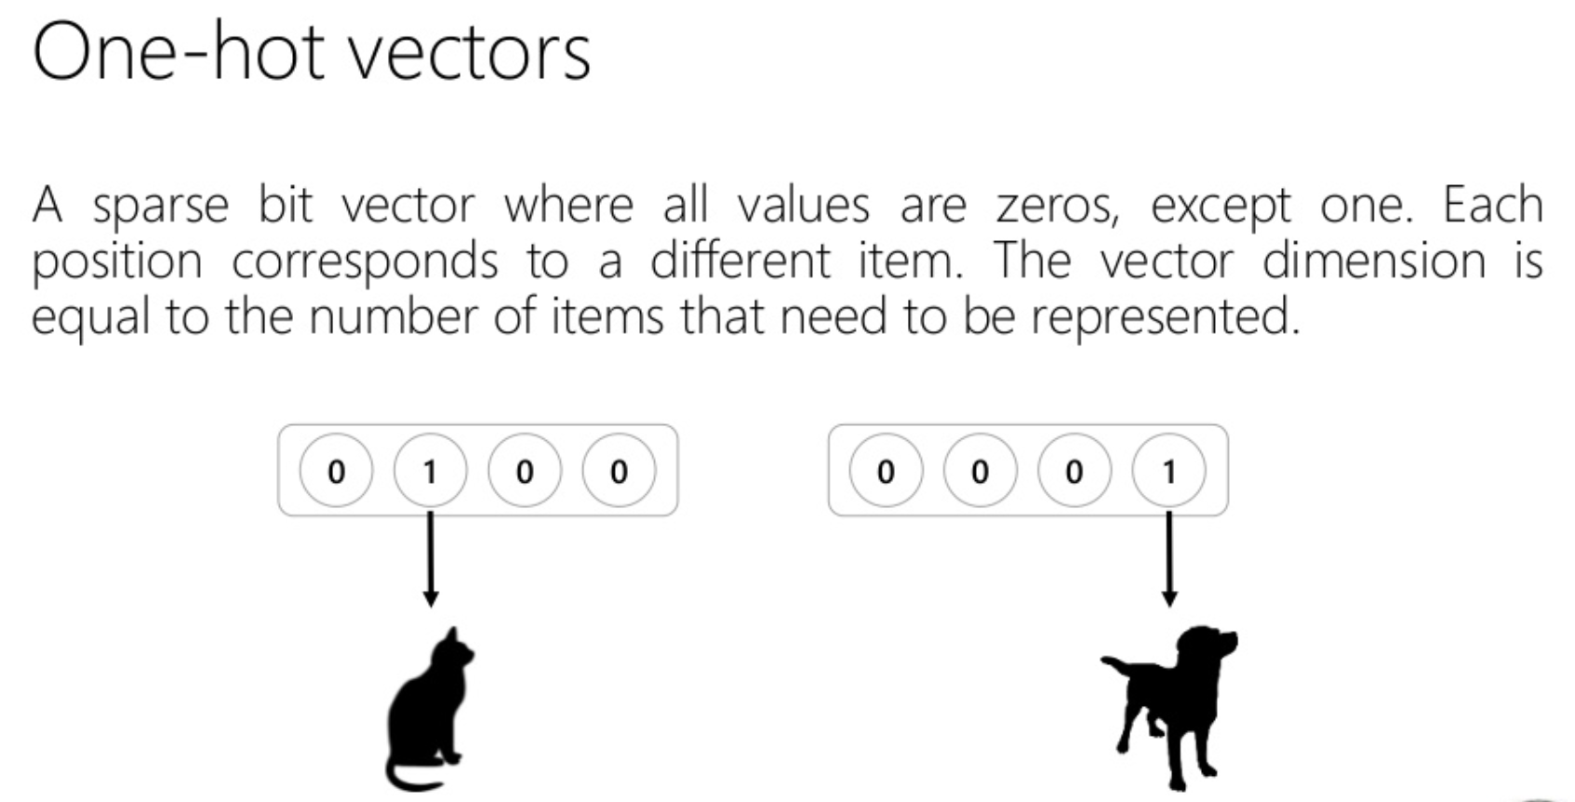

Slide 20
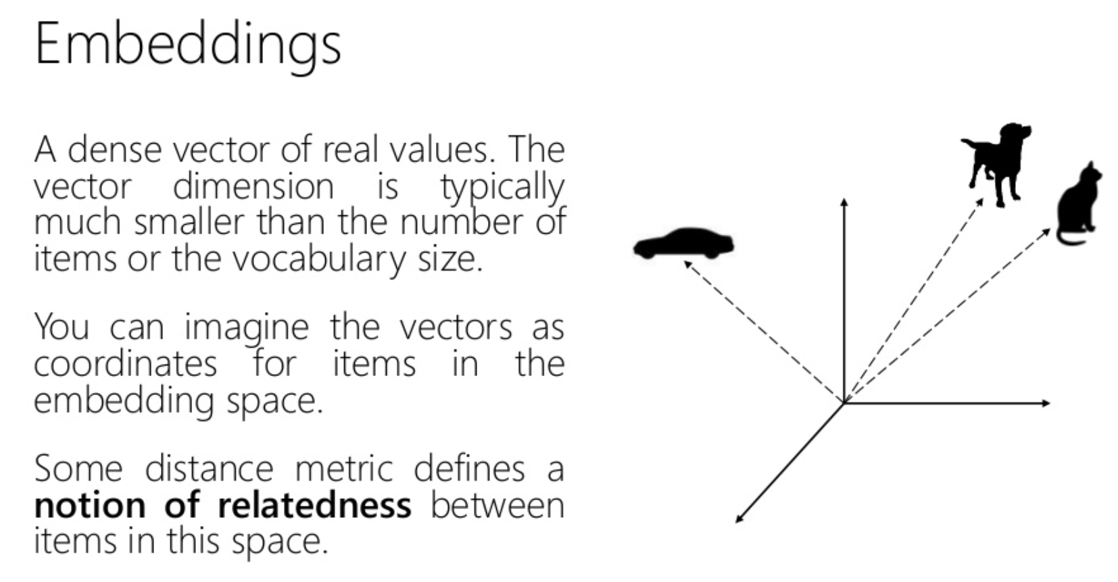

Slide 21
#times user saw this item
#clicks
item age (#hours)
…
2
16
17
…
Platform
campaign-safety
content-category
...
iPhone
Primium
sport
…

Slide 22
Campaign-Safety:
Safe Sensitive
Gossip
Restricted
Safe Positive
Premium
Racy
a1
a2
a3
a4
a5
a6

Slide 23
#times user saw this item
#clicks
item age (#hours)
…
2
16
17
…
x
x
x
x
w1
w2
w3
…
+
+
+
+
Platform
campaign-safety
content-category
...
iPhone
a
sport
…
x
w6
…
+
=
3.2% prob for click

Slide 24
Campaign-Safety:
Safe Sensitive
Gossip
Restricted
Safe Positive
Premium
Racy
a1
a2
a3
a4
a5
a6
100
12
50
150
1000
5

Slide 25
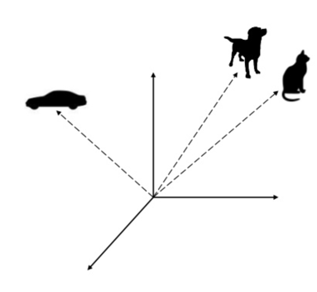
Content Category:
Dogs
Cars
Cats
Sport…
x1,y1,z1
x2,y2,z2
x3,y3,z3
…
Embeddings!!!

Slide 26
#times user saw this item
#clicks
item age (#hours)
…
2
16
17
…
x
x
x
x
w1
w2
w3
…
+
+
+
Platform
campaign-safety
content-category
...
iPhone
a
x,y,z
…
x
x
w6
w7,w8,w9
…
+
+
=
3.2%

Slide 29
The Real World

Slide 30
OOV - Out Of Vocabulary
How to treat the unknown\rare values?
Must Generate OOV value
Rare values in data
set as OOV
OOV injection
randomly per category
cross all related features? (When dealing with >1 categorical features)

Slide 31
Creating Embeddings step-by-step
Decide on a min-support for creating embedding -> set OOV threshold
phone
phone
desktop
phone
smart-fridge
phone
desktop
tablet
tablet
phone
phone
desktop
tablet
…
statistics
phone 800
desktop 350
smart-fridge 2
tablet 120
min-support?

Slide 32
Creating Embeddings step-by-step
Decide on a min-support for creating embedding -> set OOV threshold
OOV injection? -> randomly set values in training to OOV

Slide 33
Creating Embeddings step-by-step
Decide on a min-support for creating embedding -> set OOV threshold
OOV injection? -> randomly set values in training to OOV
Map each categorical feature to an index (integer)
phone 1
desktop 2
smart-fridge 0 (OOV)
tablet 3

Slide 34
Creating Embeddings step-by-step
Decide on a min-support for creating embedding -> set OOV threshold
OOV injection? -> randomly set values in training to OOV
Map each categorical feature to an index (integer)
Create a lookup table between an index and a vector
phone 1
desktop 2
smart-fridge 0 (OOV)
tablet 3
K-dim embedding vector

Slide 35
Creating Embeddings step-by-step
Decide on a min-support for creating embedding -> set OOV threshold
OOV injection? -> randomly set values in training to OOV
Map each categorical feature to an index (integer)
Create a lookup table between an index and a vector
Initialize vectors randomly
0.1 | 0.6 | 3.4 | 0.1 | -1 | -2
2.6 | -1 | 0.5 | 6.5 | 0.4 | 6.5
2.2 | 0.9 | 3.9 | 1.5 | -4 | 2.5
-3 | -1 | -2 | 1.7 | 1.2 | 3
phone 1
desktop 2
smart-fridge 0 (OOV)
tablet 3
Good Embedding?
K-dim embedding vector

Slide 36
Creating Embeddings step-by-step
Decide on a min-support for creating embedding -> set OOV threshold
OOV injection? -> randomly set values in training to OOV
Map each categorical feature to an index (integer)
Create a lookup table between an index and a vector
Initialize vectors randomly
Use the embedding to calculate some cost

Slide 37
Creating Embeddings step-by-step
Decide on a min-support for creating embedding -> set OOV threshold
OOV injection? -> randomly set values in training to OOV
Map each categorical feature to an index (integer)
Create a lookup table between an index and a vector
Initialize vectors randomly
Use the embedding to calculate some cost
Optimization: Gradient descent (back propagate) to learn the embeddings

Slide 38
How can we use Embeddings in a model?

Slide 39
How can we learn embeddings?
”Simple” regression
1st feature embedding
.
.
.
=
W_{nX1}
ctr
K^{th} feature embedding

Slide 40
How can we learn embeddings?
”Simple” regression
1st feature embedding
Adding “hidden” layer
.
.
.
W_{nXm}
=
W_{mX1}
ctr
K^{th} feature embedding

Slide 41

How can we learn embeddings?
”Simple” regression
Matrix factorization
ctr
USER_EMBEDDING_{nX1}
ITEM_EMBEDDING_{nX1}
1st USER feature embedding
K^{th} USER feature embedding
1st Item feature embedding
K^{th} Item feature embedding

Slide 42
How can we learn embeddings?
”Simple” regression
Matrix factorization
ctr
USER_EMBEDDING_{nX1}
ITEM_EMBEDDING_{nX1}
Adding “hidden” layer
hidden layers
hidden layers
1st USER feature embedding
K^{th} USER feature embedding
1st Item feature embedding
K^{th} Item feature embedding

Slide 43
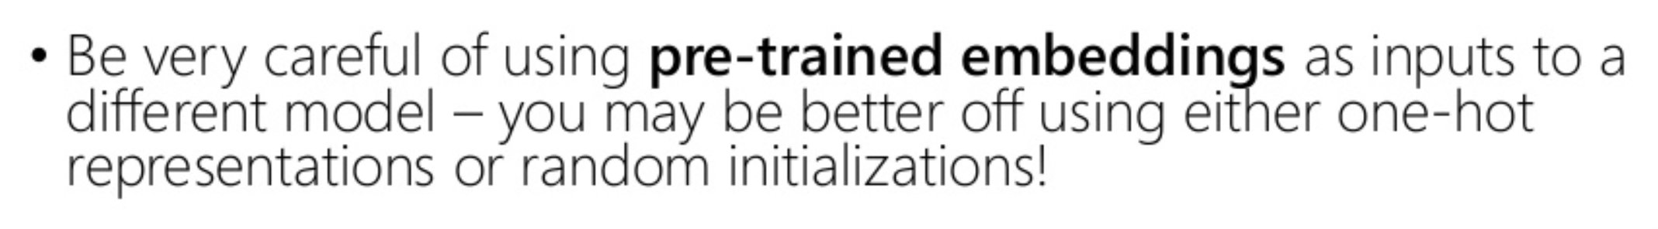
Extras
Multiple-Category Categorical features:
Such as:
User most visited sites
page-category (tech+fashion, gossip+fashion+celebs, politics+celebs)
How should we represent them?
Pre-trained embeddings:

Slide 44
Workshop Intro to TensorFlow
May 2018

Slide 45
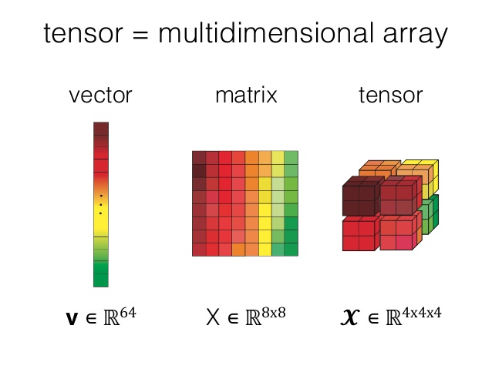
Tensor ?

Slide 46
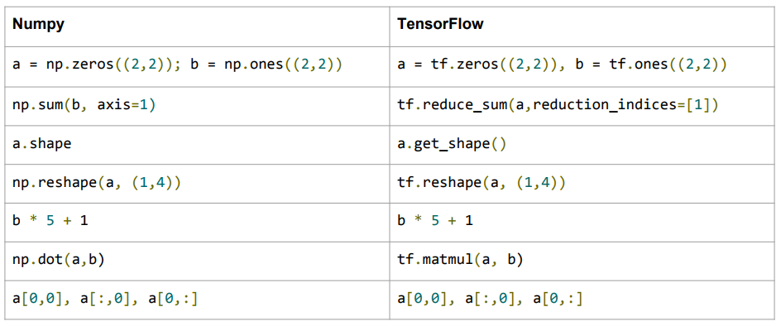
Numpy to TensorFlow Dictionary

Slide 47
Numpy to TensorFlow Dictionary
Differences?

Slide 48
Numpy to TensorFlow Dictionary
Differences?
derivatives!

Slide 49
TensorFlow Computation
y=wx+b
2 Phases:
Construction of graph
Execution phase
Objects:
Inputs (“placeholders”)
Operation nodes (“ops”)
Variables (for ML)
y
add
b
matmul
W
x
Notes:
Each instance we add is automatically added to the default graph.

Slide 50
TensorFlow Computation
y=wx+b
2 Phases:
Construction of graph
Execution phase
Objects:
Inputs (“placeholders”)
Operation nodes (“ops”)
Variables (for ML)
All these are tensors.
y
add
b
matmul
W
x
Notes:
Each instance we add is automatically added to the default graph.

Slide 51
TensorFlow Computation
cost
2 Phases:
Construction of graph
Execution phase
Objects:
Inputs (“placeholders”)
Operation nodes (“ops”)
Variables (for ML)
y
labels
Forward
add
b
matmul
W
x
Notes:
Each instance we add is automatically added to the default graph.

Slide 52
TensorFlow Computation
cost
2 Phases:
Construction of graph
Execution phase
Objects:
Inputs (“placeholders”)
Operation nodes (“ops”)
Variables (for ML)
y
BackProp
add
b
matmul
W
Notes:
Each instance we add is automatically added to the default graph.

Slide 53
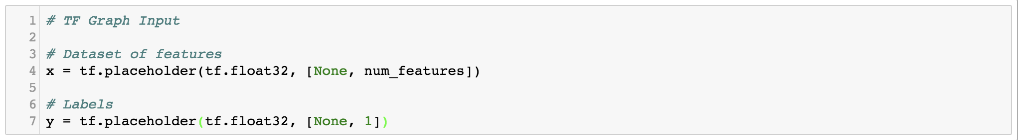
Let’s Look at Our Code

Slide 54
Let’s Look at Our Code: Placeholders
Nice trick to make this flexible to different batch sizes

Slide 55
Variables
Initial values
naming

Slide 56
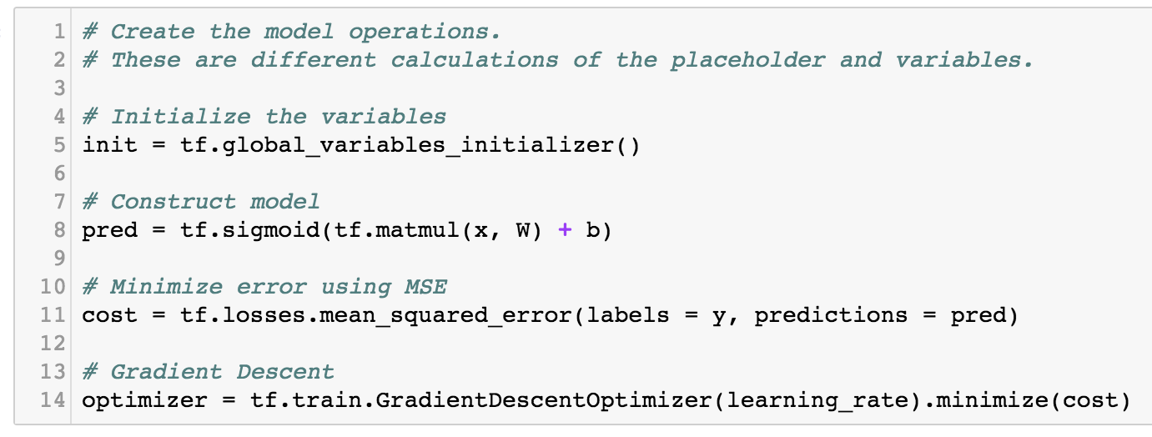
Operations
cost
initialization
pred
labels
add
b
matmul
Remember the lazy execution: Nothing run yet!
W
x

Slide 57
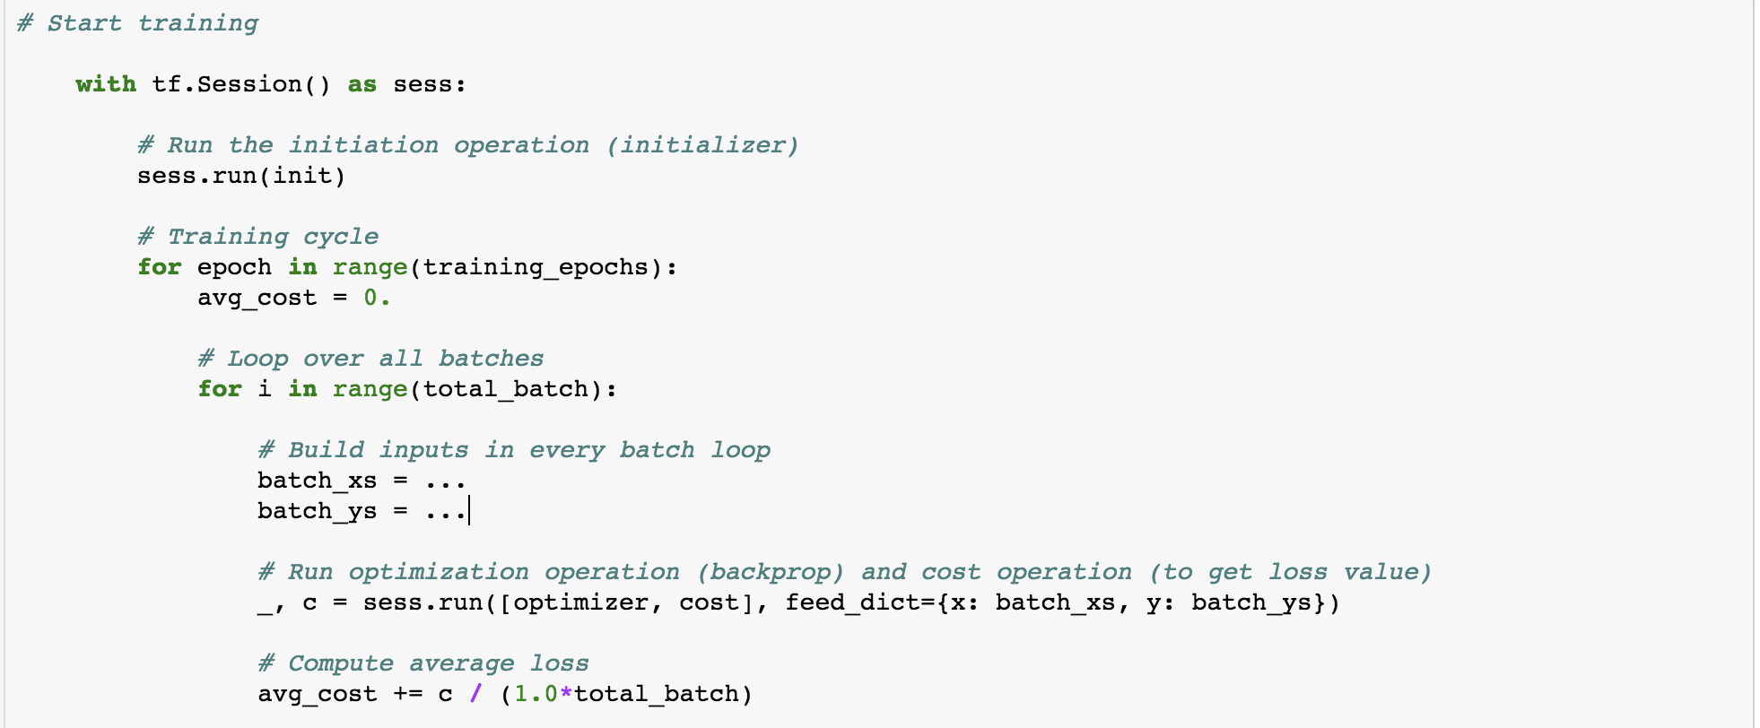
Session

Slide 58
Thank You

